Slide 1

The Power of Gratitude
‘Be grateful to Allah, and whoso is grateful, is grateful for the good of his own soul.’ [27:41]
Ahsan Mahmood Khan
Ansar Leadership Conference
January 14, 2023

Slide 2
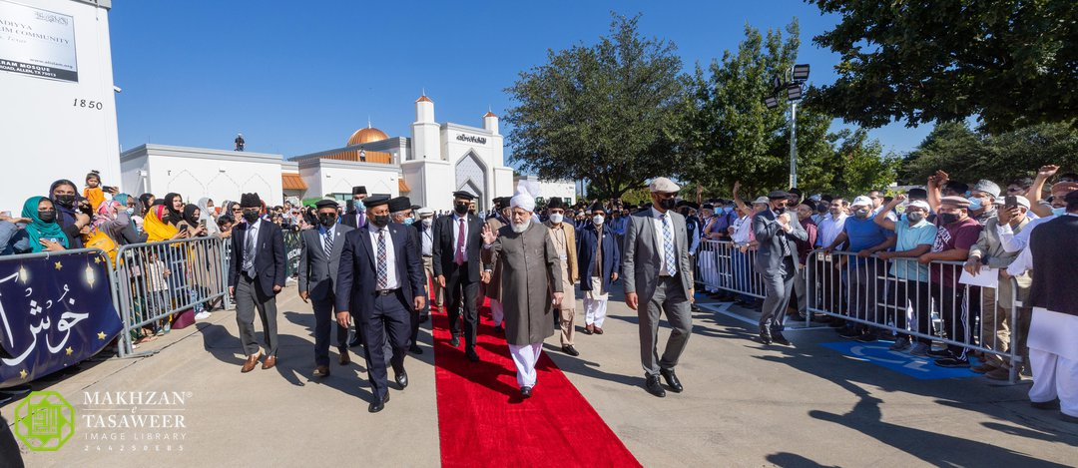

Slide 3

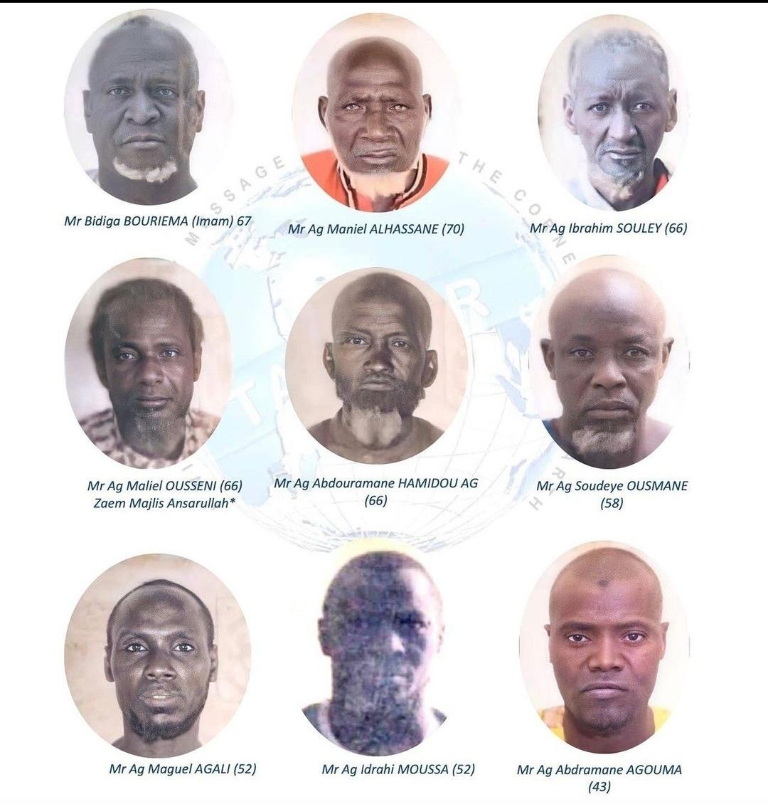
Pledge of Ansarullah
I solemnly pledge that I shall endeavor throughout my life for the propagation and consolidation of Aḥmadiyyat in Islam, and shall stand guard in defense of the institution of Khilafat. I shall not hesitate to offer any sacrifice in this regard. Moreover, I shall exhort my children to always remain dedicated and devoted to Khilafat. Insha’Allah.

Slide 4
OBJECTIVES:
Gratitude (core concepts from Qur’an)
Gratitude (practical steps)
Giving Feedback
Conflict Resolution
FORMAT:
This is a workshop, not a TED Talk
In groups, but everyone’s opinion matters
Please raise your hand and introduce yourself
DISCLAIMER
I’m not a Murabbi
To err is human, seeking forgiveness in advance

Slide 5
Think of an act of kindness someone did to you?

Slide 6
What is Gratitude (Shukr)?

Slide 7
Shukr
Gratitude is found 69 times in Holy Qur’an, ungratefulness 32 times
(76:4) Indeed, We guided him [i.e., man] to the way, be he grateful (shākir) or be he ungrateful (kafūr).
The word gratitude comes from the Latin word gratia, which means grace, the feeling of being thankful.
Definition: To recognize the goodness one receives
A feeling, behavior, social transaction
A form of worship
Born out of love and humility
An obligation
Gratitude is the greatest virtue, and mother of all other virtues

Slide 8
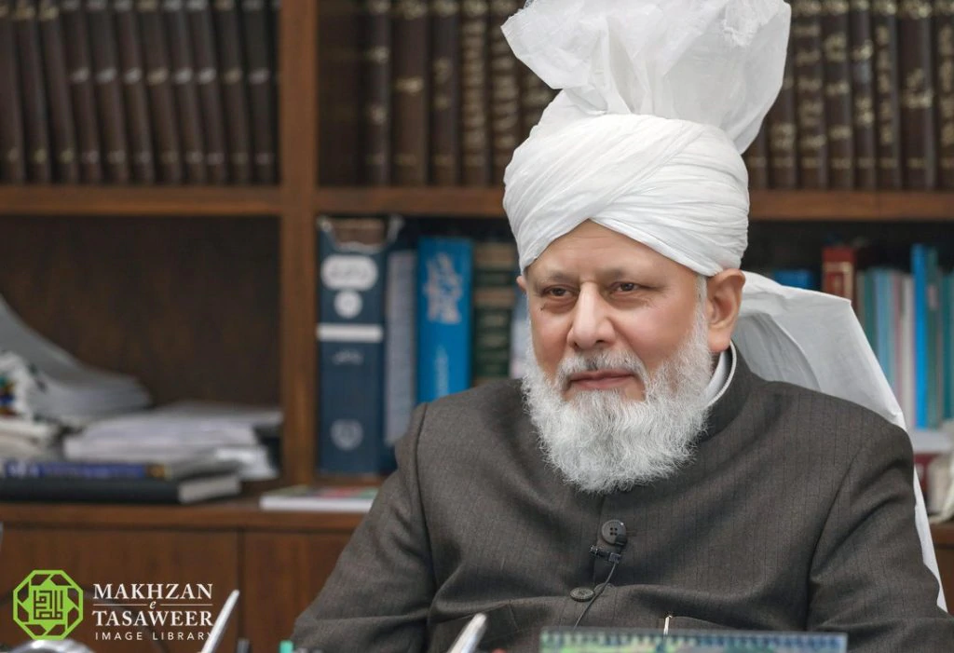
“What is gratitude? Gratitude is that a person’s entire existence should prostrate before God in humility and express his Love for Divine, to make efforts to gain that Love, to affirm that every blessing in his life is from God indeed, to declare, with words from the tongue, the praise and glory of The Lord, and to utilize His gifts such that they become a source of gaining God’s pleasure. Allah Almighty showers such servants with increased blessings and bounties.”
Hazrat Khalifatul Masih V (aba), Friday Sermon, July 13, 2012

Slide 9
Shukr
Shukr bi'l-qalb - gratitude expressed by our inner feeling of what is in our heart
Shukr bi'l-lisan - gratitude expressed by tongue and what we say
Shukr bi'l-badan wa'l-arkan - gratitude expressed by body and limbs in our good deeds and actions

Slide 10
Gratitude to Allah:
Four themes of shukr in Qur’an
Theme 1: Qur’an gave us reasons to be thankful.
“Count your blessings”
Theme 2: appreciating what Allah has given us by reflecting on His perfect names and attributes
“Reflect on His attributes”
Theme 3: consequences of not engaging in shukr
“Don’t be ungrateful”
Theme 4: the command to engage in shukr and to be of the shākirūn.
“Thank You” in words and actions
(Adopted from Yaqeen Institute)

Slide 11
Theme 1: Reasons to be Thankful
List things you are grateful to Allah for that were responsible for bringing you from your homes to the ALC

Slide 12
Shukr for things which can be taken for granted
FOOD/SUSTENANCE
(2:172): O you who have believed, eat from the good [i.e., lawful] things which We have provided for you and be grateful to Allah if it is [indeed] Him that you worship.
EASE IN SALAT DURING TRAVEL
(5:6): O you who have believed, when you rise to [perform] prayer, wash your faces and your forearms to the elbows and wipe over your heads and wash your feet to the ankles. And if you are in a state of ritual impurity [janābah], then purify yourselves. But if you are ill, or on a journey, or one of you comes from the place of relieving himself, or have been intimate with your wives and cannot find water, then seek clean earth and wipe over your faces and hands with it. Allah does not intend to make difficulty for you, but He intends to purify you and complete His favor upon you so that you may be grateful.
HUMAN PHYSIOLOGY
(16:78): And Allah has extracted you from the wombs of your mothers not knowing a thing, and He made for you hearing and vision and hearts [i.e., intellect] that perhaps you would be grateful.
DAY AND NIGHT CYCLE
(25:63) And He it is Who has made the night and the day, each following the other, for him who desires to remember, or desires to be grateful.

Slide 13
Shukr can never be enough
وَاٰتٰٮکُمۡ مِّنۡ کُلِّ مَا سَاَلۡتُمُوۡہُ ؕ وَاِنۡ تَعُدُّوۡا نِعۡمَتَ اللّٰہِ لَا تُحۡصُوۡہَا ؕ اِنَّ الۡاِنۡسَانَ لَظَلُوۡمٌ کَفَّارٌ
And He gave you all that you wanted of Him; and if you try to count the favours of Allah, you will not be able to number them. Verily, man is very unjust, very ungrateful. (14:35)

Slide 14
Innumerable Favors of Allah
“Which, then, of the favours of your Lord will you twain deny?”
فَبِاَیِّ اٰلَآءِ رَبِّکُمَا تُکَذِّبٰنِ

Slide 15
Theme 2: Reflecting on Allah’s Attributes
وَلِلّٰہِ الۡاَسۡمَآءُ الۡحُسۡنٰی فَادۡعُوۡہُ بِہَا
And to Allah alone belong all perfect attributes. So call on Him by these. (7:181)

Slide 16
Theme 2: Reflecting on Allah’s Attributes
List five blessings in your life where Allah’s Attributes were apparent

Slide 17
Theme 3: Avoiding ungratefulness

Slide 18
Avoid Ungratefulness
(7:10): And We have certainly established you upon the earth and made for you therein ways of livelihood. Little are you grateful.
(16:112): And Allah presents an example: a city that was safe and secure, its provision coming to it in abundance from every location, but it denied the favors of Allah. So Allah made it taste the envelopment of hunger and fear for what they had been doing.
“And remember also the time when your Lord declared, ‘if you are grateful, I will, surely, bestow more favors on you’ (14:9)
Indeed, We guided him [i.e., man] to the way, be he grateful (shākir) or be he ungrateful (kafūr). (76:4)
Ungratefulness tantamount to disbelief.

Slide 19
Theme 4: Be among the grateful
"He who does not thank people, does not thank Allah" (Ahmad, Tirmidhi).”
Benefits of Gratitude
Gratitude Journals
Islamic Acts of Gratitude

Slide 20
“It is not joy that makes us grateful; it is gratitude that makes us joyful.”

Slide 21
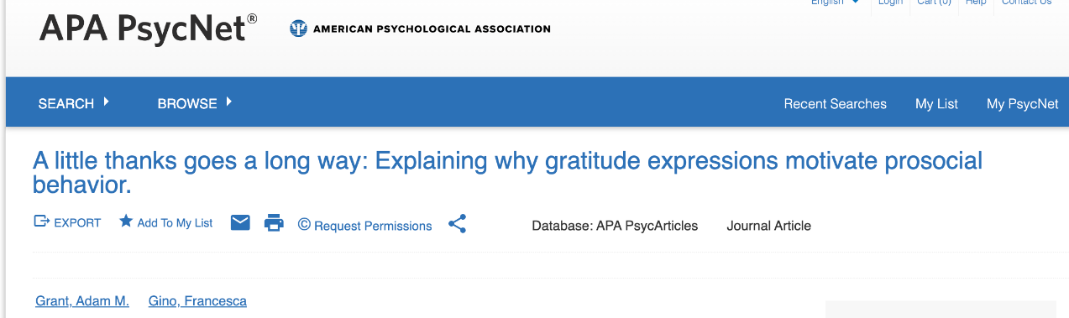
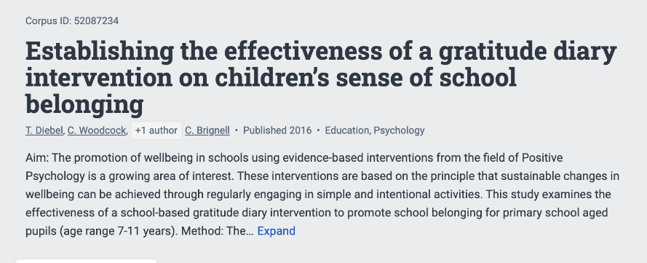
The tangible effects of gratitude
Gratitude facilitates social well-being

Slide 22
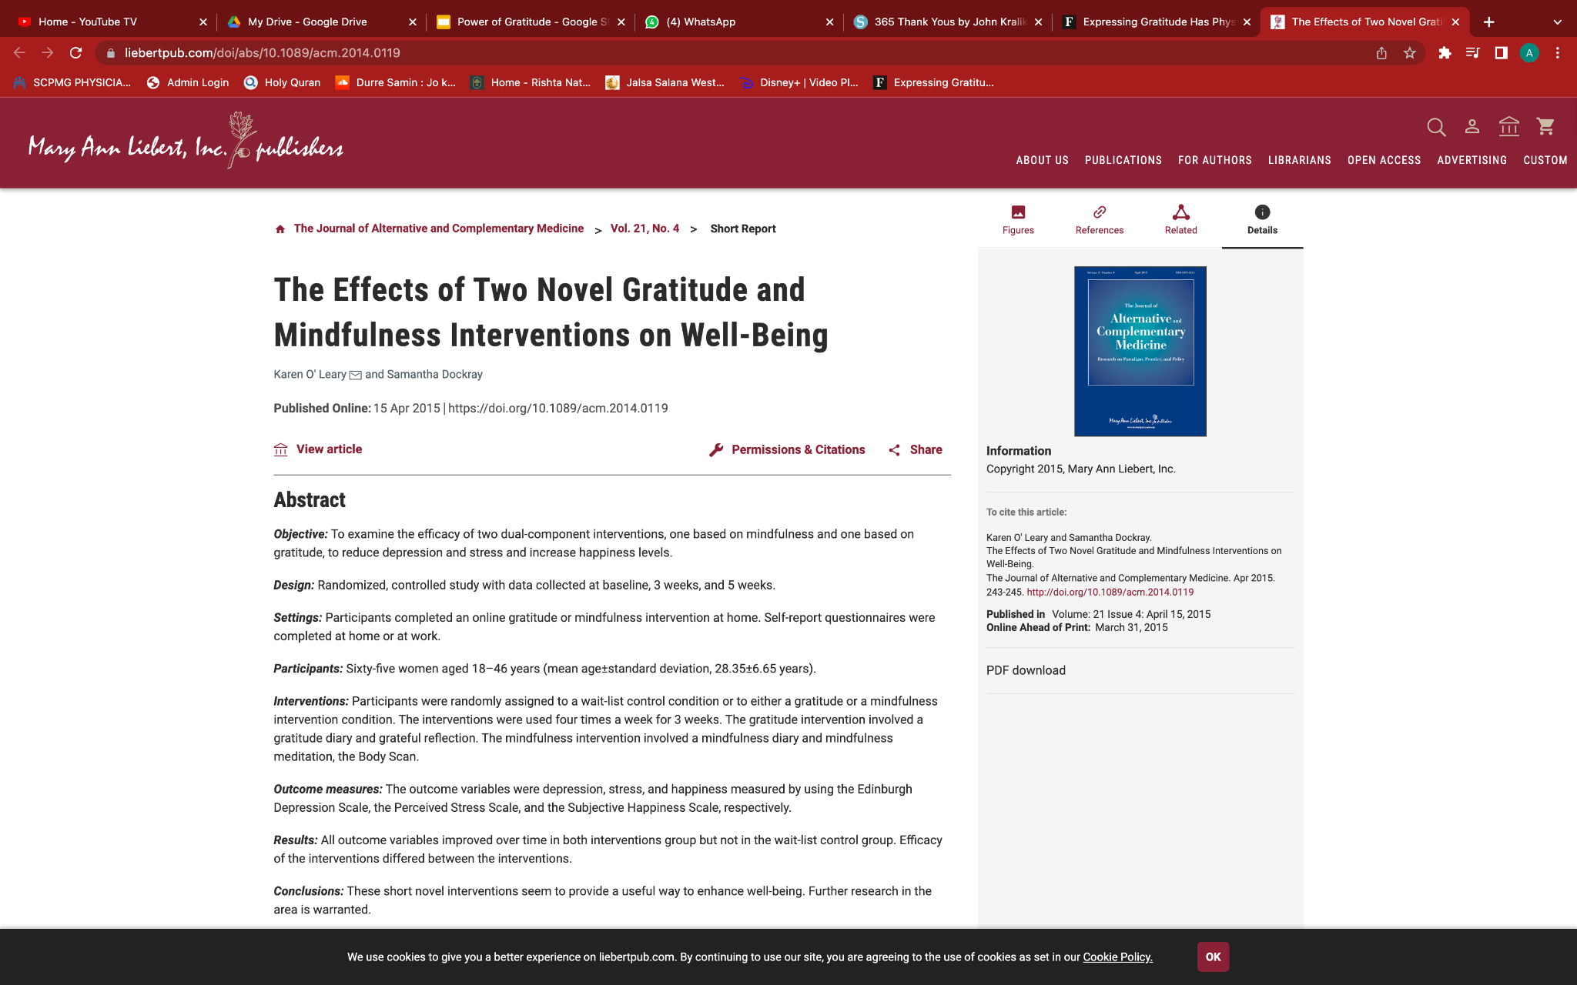
Tangible effects of gratitude
Gratitude enhances emotional well-being

Slide 23
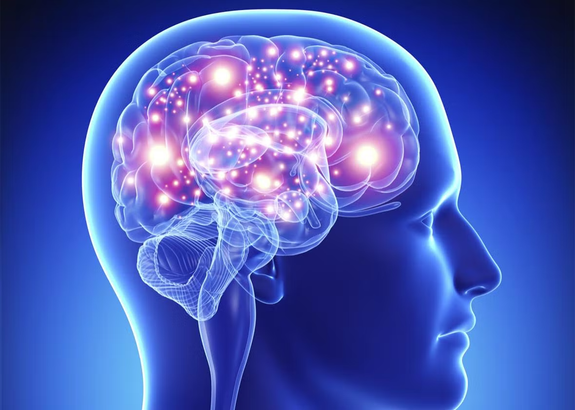
Gratitude: The Wonder Drug
Physiological and psychological changes of gratitude:
improved inflammatory and immune responses
reduced cortisol levels (the stress hormone)
increased levels of oxytocin (the bonding and love hormone)
increased levels of endorphins (natural opioids associated with pain relief)
Increased serotonin (reduction in anxiety and depression)
lower blood pressure and heart rate
improved sleep
better blood sugar control
and reduced risk of poor health and disease.

Slide 24
Tangible effects of gratitude
Gratitude benefits physical health
Keeping a gratitude journal improved diastolic blood pressure and immune function
Focusing on things to be grateful before bed each night increased pre-sleep calmness
Keeping a gratitude journal for 14 days lead to fewer headaches, clearer skin, less stomach pain and reduced congestion
People who keep a gratitude journal have a reduced dietary fat intake-as much as 25% lower. Stress hormones (cortisol) are 23% lower in grateful people. Daily gratitude practice could actually reduce the effects of aging on the brain

Slide 25
“Be Among the Grateful”
بَلِ اللّٰہَ فَاعۡبُدۡ وَکُنۡ مِّنَ الشّٰکِرِیۡنَ
Aye, worship Allah and be among the grateful. (39:67)
Practice gratitude
Gratitude journal or diary
Count blessings during your commute

Slide 26


Slide 27
“Alhamdolillah” is our gratitude journal
The Messenger of Allah ﷺ said, “The best dhikr is lā ilāha illā Allāh (None has the right to be worshipped but Allah), and the best shukr is alḥamdulillāh (praise be to Allah).”
Promised Messiah (as): God has started the Holy Qur’an with the Arabic word “hamd” (praise) in His glory as opposed to the words “madh” (applaud) or “shukr” (thankfulness) because the word Hamd encompasses the other two words
Surah Fatiha recited 4+ 10+4+5+9 = 32
Tasbeeh: 33 x 5 = 165
Salat ~ 200 Alhamdolillahs a day

Slide 28
Adopt the colors of Allah, which includes Shukr
صِبۡغَۃَ اللّٰہِ ۚ وَمَنۡ اَحۡسَنُ مِنَ اللّٰہِ صِبۡغَۃً ۫ وَّنَحۡنُ لَہٗ عٰبِدُوۡنَ ﴿۱۳۹﴾
Say, ‘We will adopt the religion of Allah; and who is better than Allah in teaching religion, and Him alone do we worship.’ (2:139)
(42:23): … And whoever commits a good deed, We will increase for him good therein. Indeed, Allah is Forgiving and Appreciative (Shakūr).
Allah is Ash-Shukoor : The Qur’an describes three ways in which this occurs:
when He rewards us abundantly
when He accepts our repentance
and when He appreciates our good works.

Slide 29
Gratitude is an Attitude
Is it negative events which make us happy, or our reaction to negative events?
مَاۤ اَصَابَکَ مِنۡ حَسَنَۃٍ فَمِنَ اللّٰہِ ۫ وَمَاۤ اَصَابَکَ مِنۡ سَیِّئَۃٍ فَمِنۡ نَّفۡسِکَ ؕ وَاَرۡسَلۡنٰکَ لِلنَّاسِ رَسُوۡلًا ؕ وَکَفٰی بِاللّٰہِ شَہِیۡدًا
Whatever of good comes to thee is from Allah; and whatever of evil befalls thee is from thyself. And We have sent thee as a Messenger to mankind. And sufficient is Allah as a Witness. (4:80)

Slide 30
Saying Thank You
Holy Prophet (sa):
Whoever receives a favor from someone should say Jazak’Allah Khair meaning “may Allah give you the best reward for it”. By saying this he has discharged his obligation of thankfulness.
Holy Prophet (sa):
If someone has done good to you, repay him and if you do not have the capacity to repay, at least pray for that person to the extent that you are sure of repaying him fully.”

Slide 31
Prostate with gratefulness
Sajdat al-shukr (prostration of gratitude)
Does not require ablution or facing Qiblah
Abu Bakr (ra) narrated,“When anything came to the Prophet ﷺ which caused pleasure (or, by which he was made glad), he prostrated himself in gratitude to Allah.”
Giving and Receiving of Gifts
Holy Prophet Muhammad (sa):
  a gift is like a provision from Allah and that one should try and give a better gift in exchange and if that is not possible then one should verbally praise the gift.
Promised Messiah (as) would appreciate gifts and even mention to his companions
Huzoor’s present day example of gratitude
  Personal letters for Hidaya/Gifts
  Post-Jalsa Salana sermons

Slide 32
Gratitude in Other Ways
Praying for someone who requests it
Just because gift or note (appreciation)
Smiling is charity
Be Specific
Be Present
A belated Thank You is still better than no thank you
Thank yous all the time/incessantly dilute their effect
If you are announcing a list of people to thank, if you may miss key people, better not to list.
Thank you is not in the words, its in how they are left feeling
Highlight the behavior that’s worthy of thanks, not the person
Public vs Private thank you’s both have their place
Use the original social media: a phone call
The gift of time
Be the first to say Salam, eye contact
An embrace is underrated
Jummah - take off Za’im hat, don’t talk shop, connect at personal level
Recognize the outstanding workers by standing in their place

Slide 33
Gratitude Spaces
Gratitude to Allah
Gratitude to Hazrat Khalifatul Masih
Gratitude to Jama’at
Gratitude to your elders
Gratitude to your co-workers
Gratitude to your parents
Gratitude to your spouse
Gratitude to your children
Gratitude to your relatives
Gratitude to your friends
Gratitude to strangers

Slide 34
Exercise: What are ways you can exhibit gratitude to your spouse/children?

Slide 35
Exercise: How to display gratitude at home
Holy Prophet (sa) gratitude towards Hazrat Khadija (ra)
The Promised Messiah (as)’s gratitude towards his wife
  The lights
“The emotional bank account”
  Giving gratitude out loud (so children hear it)
  Thoughtful cards, notes or letters
  Giving your spouse a break
  Cook a special dinner
  Let others know what your spouse does for you
  Show gratitude to your spouse when they are not there

Slide 36
Group Exercise: Conflict Resolution
You are the Za’im and conducting an Ansar amila meeting. The topic of Tabligh comes up and one amila member, afterwards, emails to you his complaint that you are bypassing the national plan and doing things which deviate from this. You reply that you are exploring new ideas and the amila meeting was the forum to bring up these counterpoints. He then responds by saying you always ignore his input anyways.
How would you handle this?

Slide 37
Handling conflict with a fellow office holder
Holy Prophet (sa): “Hearsay is not like seeing”
In person discussion always better
If legitimate complaint to go on record, cc the person involved
Keep emails to no more than three lines
Avoid prolonged email volleys
Don’t be hasty, give it 24 hours if it’s not time sensitive
Reflect, pray, reflect, istighfar, reflect, pray
Promised Messiah (as): Consider yourself lower than everyone else
Huzoor: Humble yourself even more. If the other is not satisfied with your effort, then you should humble yourself a step further. Humble yourself to the extent that the other feels embarrassed and thus, softens his sentiments for you.
“Where Stars Descend - Chapter 4: Subduing ego” - Al Hakam, July 31, 2020

Slide 38
Group Exercise: Giving Feedback
You, as local Za’im, have assigned your Muntazim Tabligh to organize a flyer distribution event involving local Ansar. He has arranged such campaigns in the past so you give him full jurisdiction to manage it. In all, 200 flyers are distributed by six Ansar (the target was participation of 20 Ansar and 1000 flyers). Two Ansar came late. Some expressed frustration that they didn’t hear about the event until the last minute. One individual did reach out to the local mosque the following week to inquire about Islam after reading the flyer given during that event. You were out of town so could not attend. Describe how you would provide feedback to your Muntazim.

Slide 39
The Feedback Fallacy
Reference: Marcus Buckingham (ADP Institute)
Three fallacies in giving feedback:
You own the truth about others
Learning is information transfer
Excellence can be defined in advance
Three truths in giving feedback:
You own your own reaction - share it
Learning is insight
Excellence is connect to the person - replay moments of excellence

Slide 40
Positive Feedback
Research study on the effectiveness of teams showed that ratio of positive feedback to negative criticism of 6:1 was prevalent in the best performing teams, 2:1 in average companies, and 0.3:1 in least effective teams.
Research into wedding couples likelihood of getting divorced or remaining married showed that those relationships with praise-to-criticism ratio of 5:1 were more likely to stay married and 0.77:1 for those ending up in divorce.
Huzoor: “When you see something in your spouse which you dislike, close your eyes, close your ears, close your mouth. When you see something you like, open all three”

Slide 41
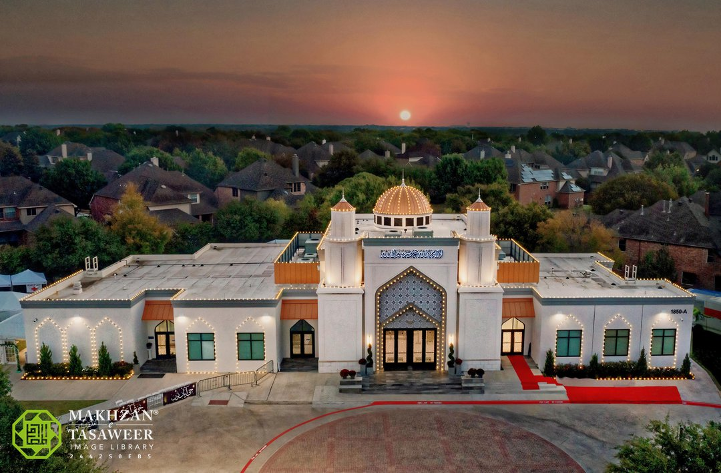
“Gratitude is when memory is stored in the heart and not in the mind.”

Slide 42
Think of an act of kindness someone did to you

